Slide 1
vector.name[n]
Indexing
vector.name[-n]
vector.name[c(n1, n2,..,ni)]
vector.name[-c(n1, n2,..,ni)]
vector.name[“element name”]
vector.name[ni:nj]
vector.name[-(ni:nj)]

Slide 2
Calling a function: The function name is followed by round brackets
( ) -------- Round brackets -------- Functions
Indexing a vector: The vector name is followed by square brackets
[ ] -------- Square brackets ------- Indexing elements of a vector

Slide 3

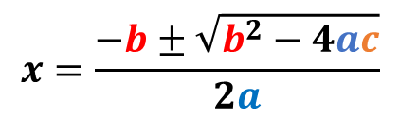
$$x=\frac{−b±\sqrt{b^{2}−4ac}}{2a}$$
List sub-setting
$$ax^{2}+bx+c=0$$
Returns
smaller list
Extracts an element
[] vs [[]]
include string variables as factors?
What is the data separator ?
Dataset name
read.table("file.name", sep =, header = , stringAsFactors = )
dataset has a header row?

Slide 4
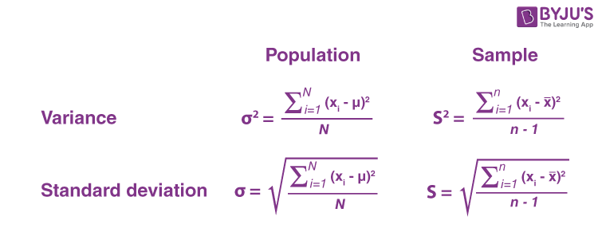
read.table("Data.csv", sep =",", header = TRUE, row.names = 1)
read.table("Data.txt", sep =" ", header = TRUE, row.names = 1)
read.table("Data.tsv", sep= "\t", header=TRUE, row.names = 1)
x₁ + x₂ + x₃ + …….. + x_{n}
n
ADJUSTS FOR
LARGER VARIABILITY

Slide 5
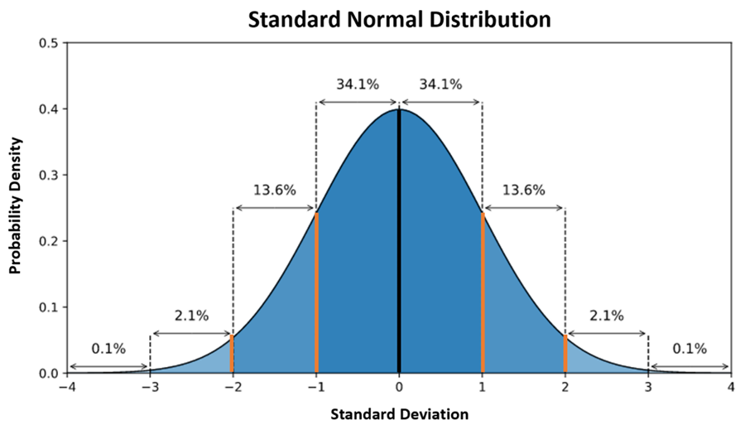

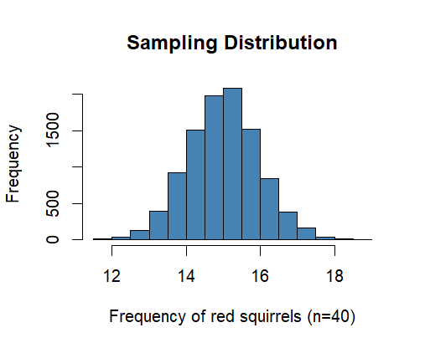
Probability Distribution

Slide 6
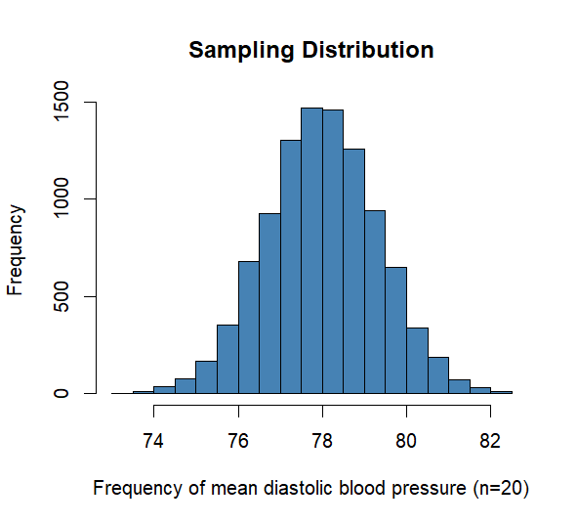

Slide 7
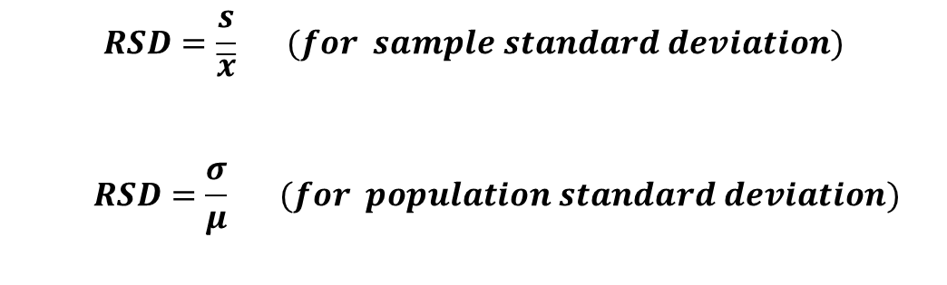
Original variable – Mean
Standard deviation
=
Z-scores
$$RSD=\frac{s}{\overline{x}} (for sample standard deviation)$$
$$RSD=\frac{σ}{μ} (for population standard deviation)$$

Slide 8

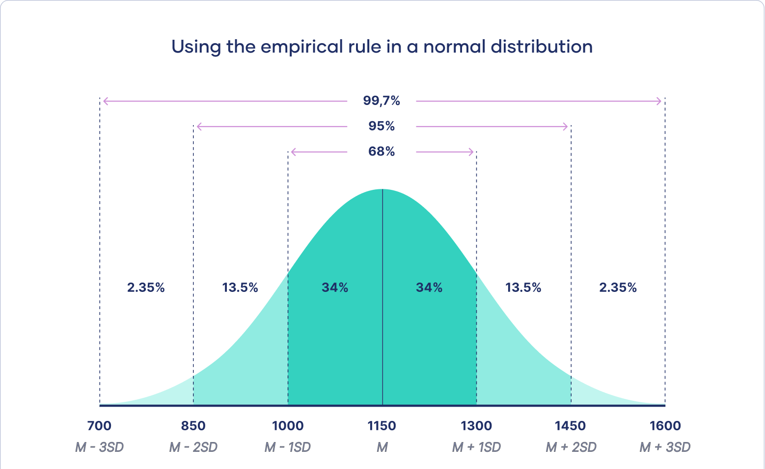

Slide 9
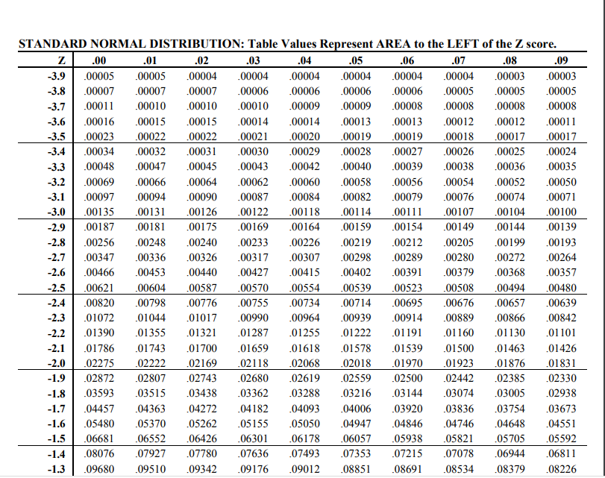
z-score = -2.53

Slide 10

R operators
Logical
Relational
Assignment
Arithmetic

Slide 11
For loop
Initiation
For every value of x
i ∈ seq
F
do y
T
body

Slide 12
Steps in data-driven decision making
Research question
Generate theory
Formulate a hypothesis
Find correct test
Conduct test
Make a decision

Slide 13

Example of two-sided hypothesis test
Hypothesis
Notation
Outcome1
Outcome2
The mean length of newborn babies in the UK is 50 cm
H₀: μ₀ = 50 cm
IF REJECTED
NOT REJECTED
The mean length of newborn babies in the UK is not 50 cm
H₁ : μ₀ ≠ 50 cm
SUPPORTED
CAN NOT BE
SUPPORTED

Slide 14
Example of one-sided hypothesis test
Hypothesis
Notation
Outcome1
Outcome2
The prevalence of anxiety disorders in US adolescents is 31.9%
H₀
IF REJECTED
NOT REJECTED
The prevalence of anxiety disorders in US adolescents > 31.9%
H₁
SUPPORTED
CAN NOT BE
SUPPORTED
σ≠

Slide 15
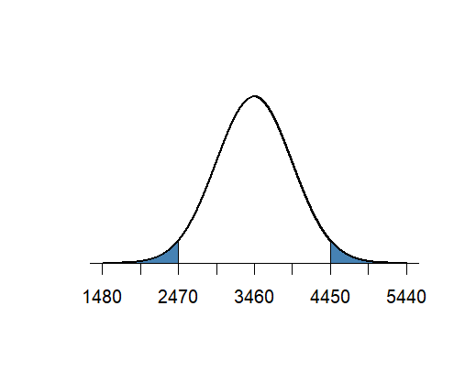
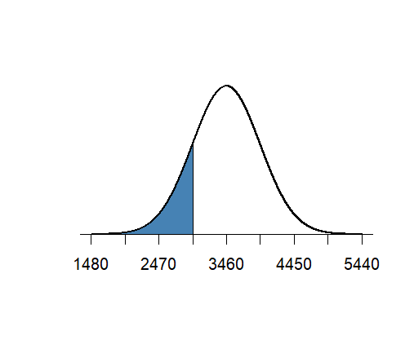
Weight at birth (g)
one-sided hypothesis test
H₀: μ = 3900 g
H₁: μ ≠ 3900 g
Weight at birth (g)
Rejection region
Rejection region
Statement
H₀: μ = 3900 g
H₁: μ < 3900 g
α/2
α/2
Rejection region
Statement
α
True mean
True mean
Notes:
Two-side alternative: Any H0 value within the acceptance area (white) cannot be rejected.
One-sided left: Any H0 value >2470 cannot be rejected. The normal curve is the real population distribution. For one sided a=0.05 criterion, we

Slide 16
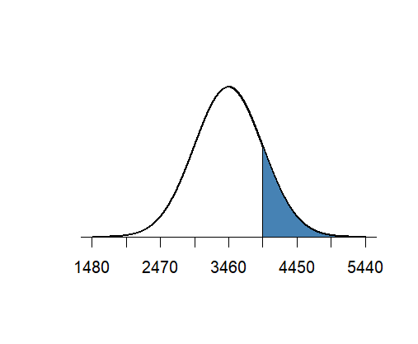
one-sided hypothesis test
Weight at birth (g)
Weight at birth (g)
H₀: μ = 3900 g
H₁: μ < 3900 g
H₀: μ = 3900 g
H₁: μ > 3900 g
Rejection region
Rejection region
α
α
True mean
True mean

Slide 17
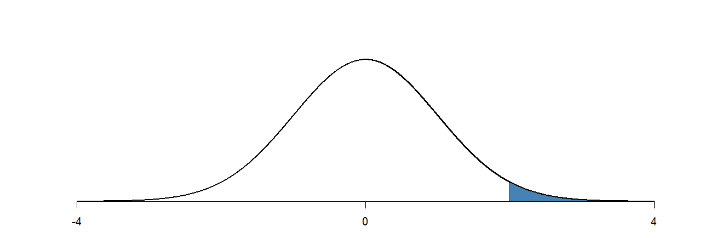
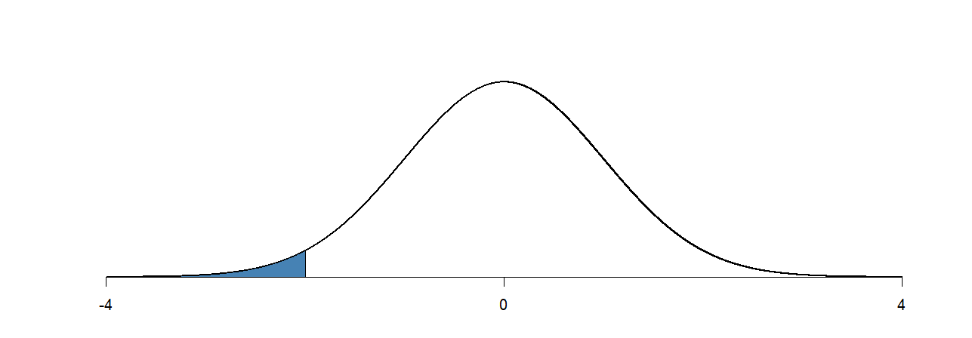
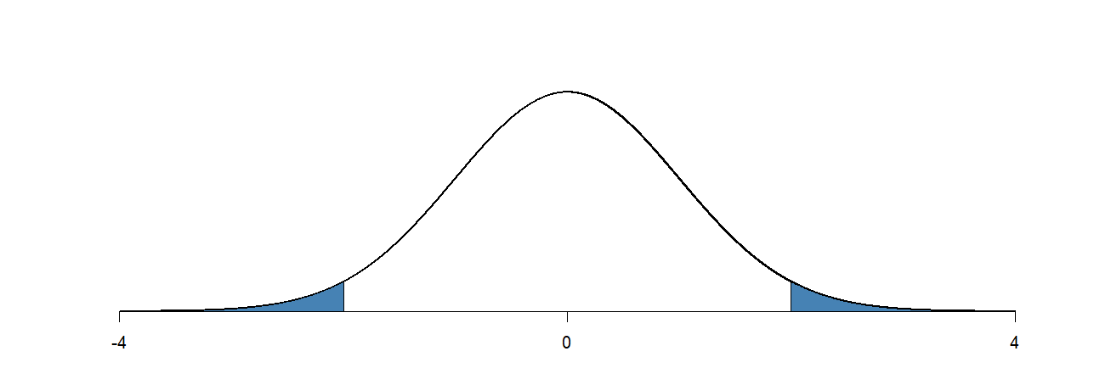
z Test for Population Mean
H₁: μ > μ₀
P(Z ≥ z)
z
H₁: μ < μ₀
P(Z ≤ z)
z
H₁: μ ≠ μ₀
2P(Z ≥ |z|)
|z|

Slide 18
t Test for Population Mean
H₁: μ > μ₀
P(T ≥ t)
t
H₁: μ < μ₀
P(T ≤ t)
t
H₁: μ ≠ μ₀
2P(T ≥ |t|)
|t|

Slide 19
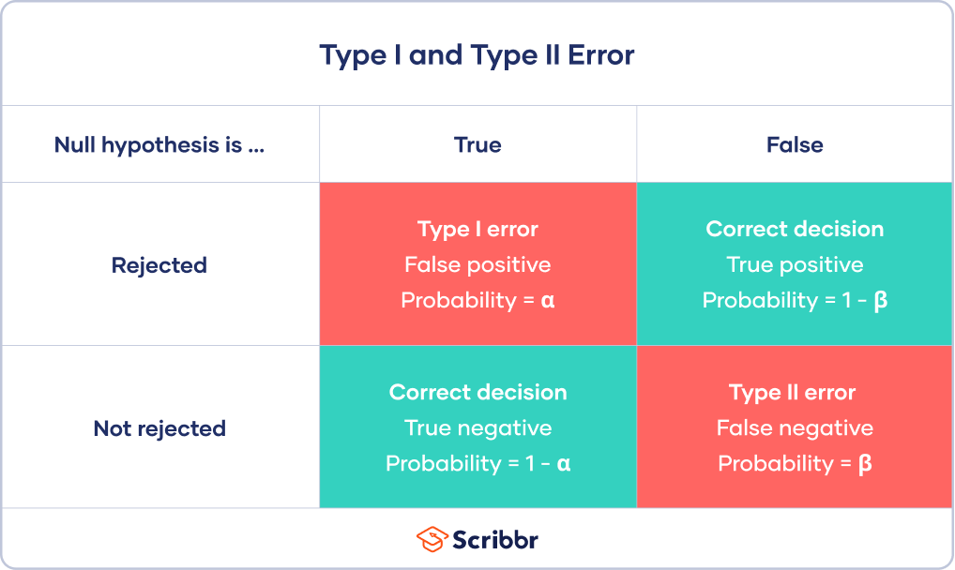
Power of the test

Slide 20
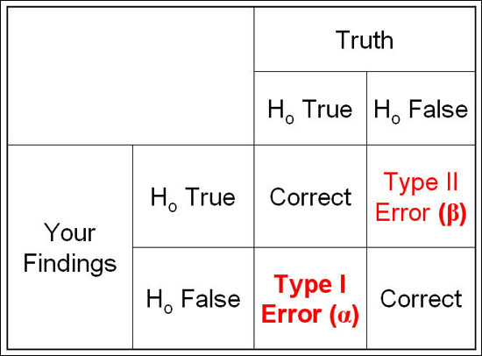

Slide 21
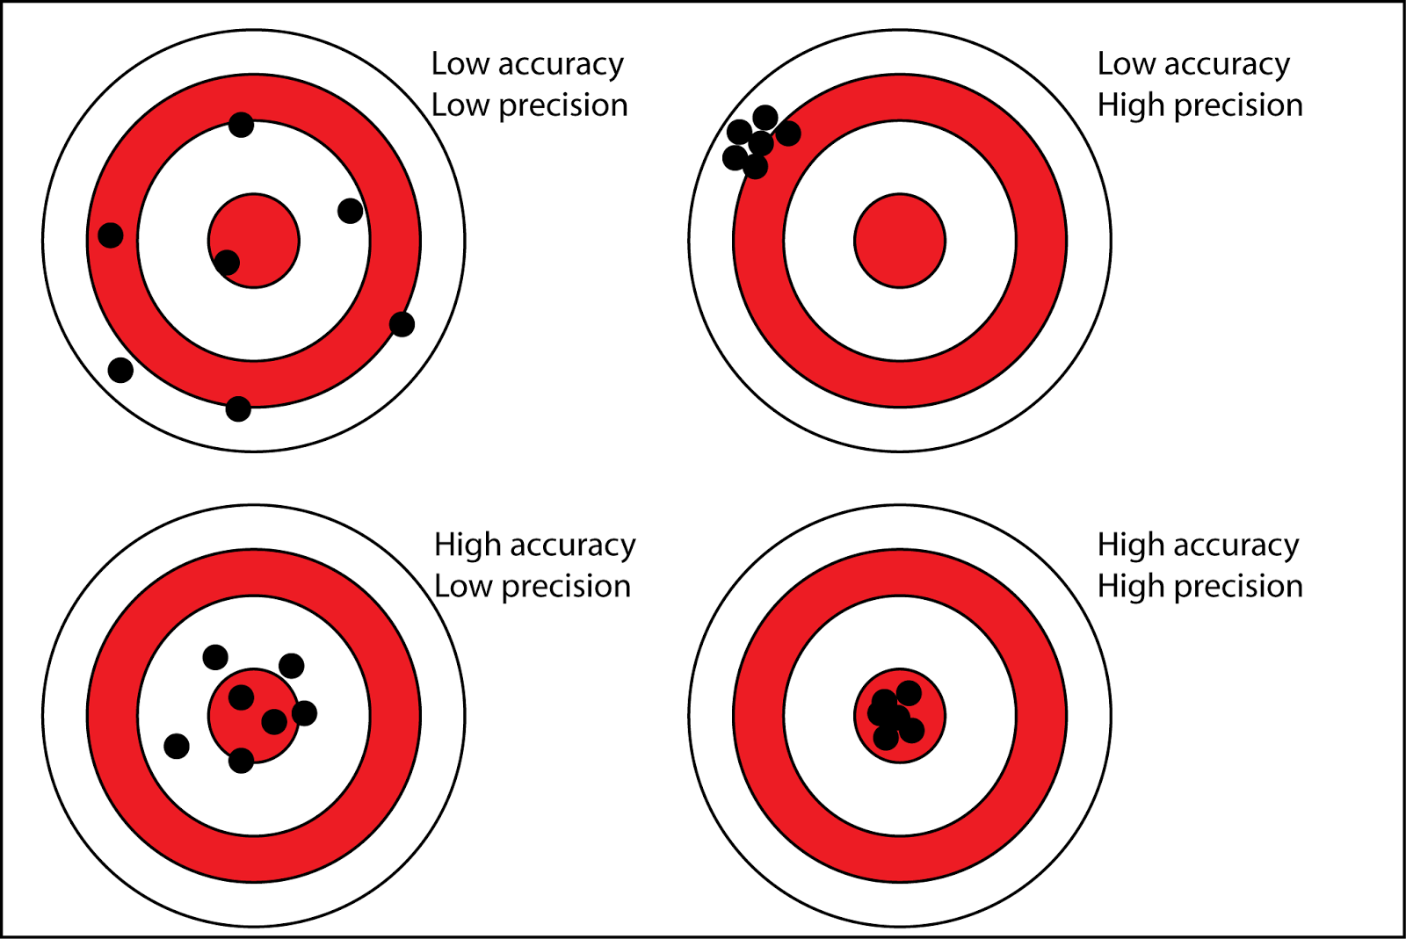

Slide 22
Population SD known: one-sample z test, two-sample z-test
Population SD unknown: one-sample t-test, two-sample t-test
d≠, ±

Slide 23
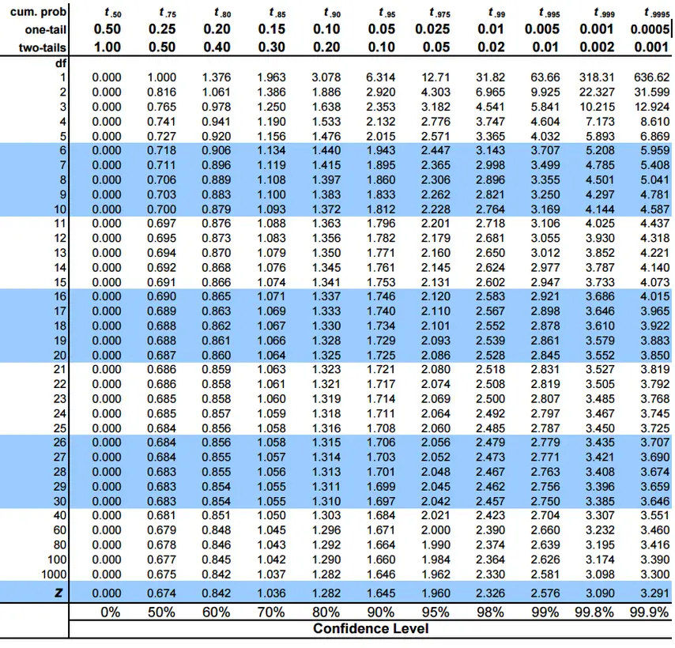

Slide 24
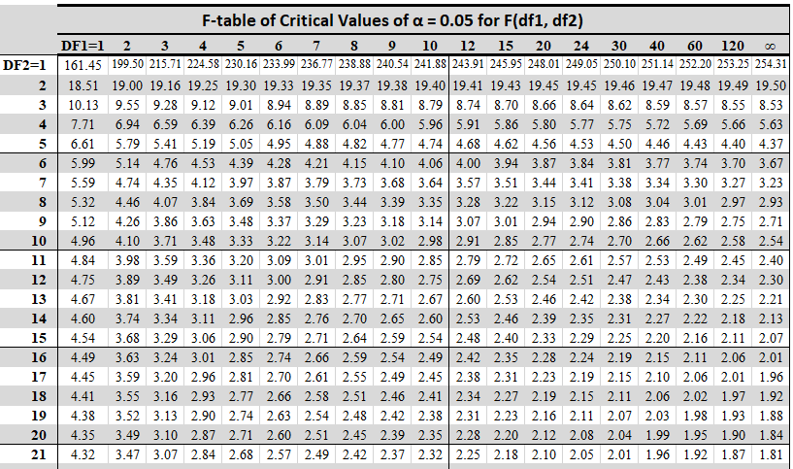

Slide 25
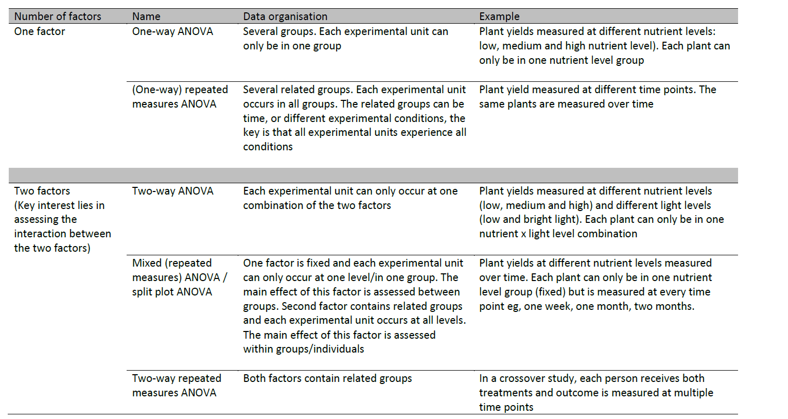
Source: Jenny Freeman, The University of Sheffield

Slide 26
Residual Assumptions
Assumption | How to Check | What to Do if Not Met
1. Residuals are normally distributed | Check histogram and QQ plots of residuals. Shapiro-Wilk's Test for normality | Consider data transformation (e.g. sqrt or log). If still not normal use a non-parametric test (Kruskall- Wallis)
2. Homogeneity of variance (The variances s² should be equal for all groups) | Residuals vs fitted plot. Levene test for equality of variances | If p-value < 0.05, consider data transformation or use the Welch test

Slide 27
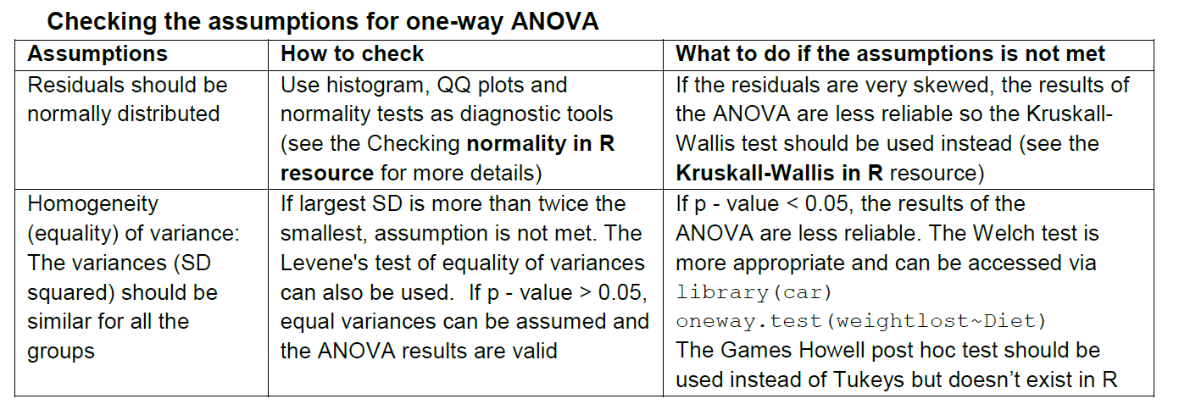

Slide 28
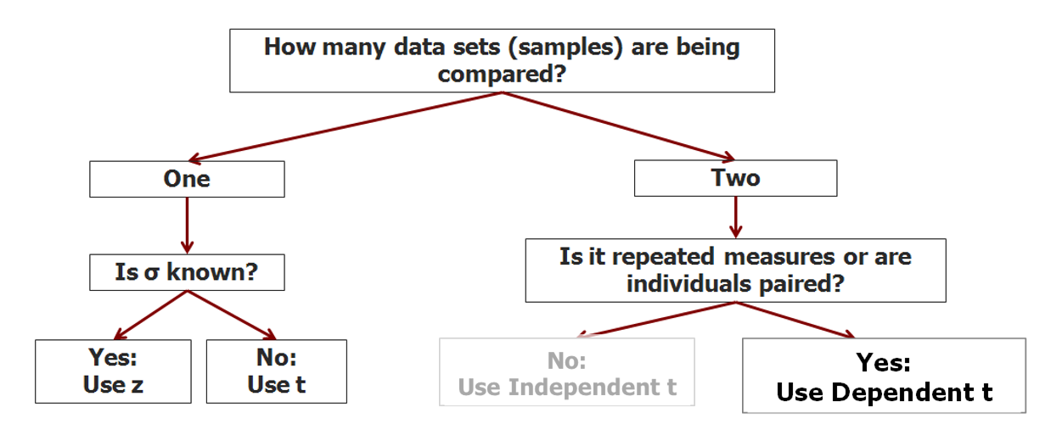

Slide 29
How Many Datasets Are Being Compared?
One
Two
Is σ known?
Yes
Use z-test
No
Use t-test
Is it paired data?
Yes
Use paired t-test
No
Use two-sample t-test

Slide 30
Is σ known?
Yes
No
Is it paired data?
Yes
No
Yes
No
Independent?
Yes
No
More than one Factors?
Yes
No
More than one Factors?

Slide 31
